Slide 1
A Brief Introduction to Structured Query Language
You Say ‘Sequel,’ I Say ‘Ess-Que-Ell’

Slide 2
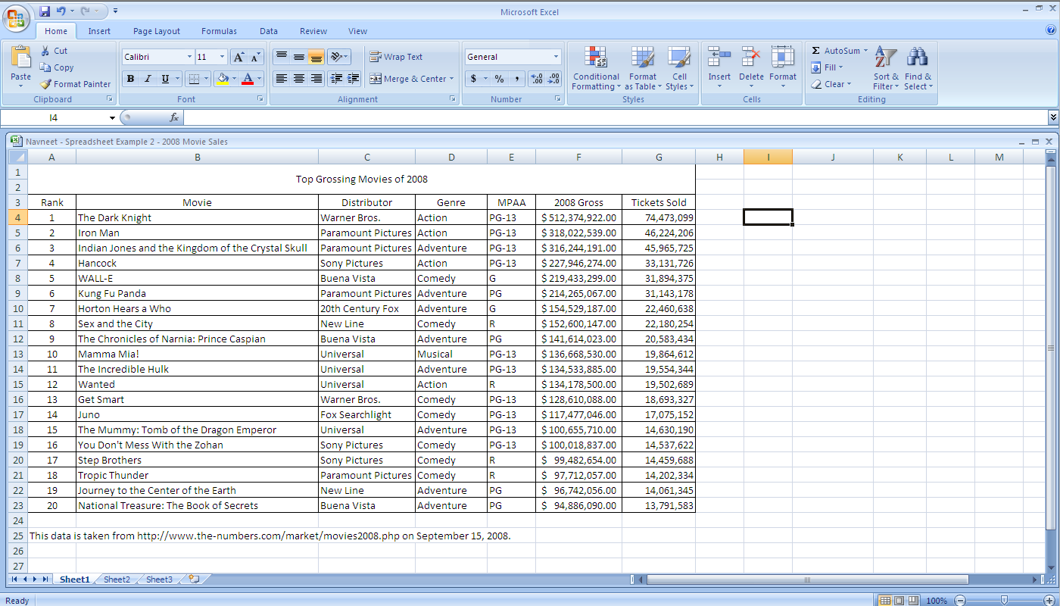
What is a Database?
Primary Key
Notes:
Databases can be thought of as tables
These tables in database systems are usually nouns
Their columns (or attributes) describe an aspect of them
Each row is an instance (or entry) of the overall noun
Primary keys – must bet unique, cannot be null

Slide 3
Relational Database
Create databases with some relationship between them
Rules of thumb:
Don’t want repeat values or (repeat) NULL values
customer sales_transaction
id | name | address
1 | Karen | 234 Main St
2 | Bob | 930 Cat Blvd
id | cust_id | item
1 | 2 | Pokédoll
2 | 2 | Barbie
3 | 1 | Protein Powder

Slide 4
What is SQL?
English-like language used to enter, modify, search for, or delete data from a database
Structured Query Language
SQL statements always end in a semi-colon.

Slide 5
What can it do?
It can:
Search for some data satisfying certain criteria (SELECT)
Add a new row of data to a table (INSERT)
Change a cell of data whose row already exists (UPDATE)
Remove a row of data from a table (DELETE)
Create new databases
Create new tables in a database
Create stored procedures in a database
Create views in a database
Set permissions on tables, procedures, and views.

Slide 6
SELECT
number_of_pets
Ask questions of a table
Get an answer
“Tell me the ID number of any person who has no pets”
id | name | pets
1 | Josh | 2
2 | Asher | 0
3 | Jessica | 1
Primary Key!
SELECT id FROM number_of_pets WHERE pets = 0;
SELECT column FROM table WHERE criteria;
SELECT id
FROM number_of_pets
WHERE pets = 0;
Notes:
CASE SENSITIVE!!

Slide 7
INSERT
number_of_pets
Let’s add data by using INSERT
Column order will stay the same
Non-numeric data must be enclosed in quotation marks.
id | name | pets
1 | Josh | 2
2 | Asher | 0
3 | Jessica | 1
4 | Ben | 4
INSERT INTO number_of_pets ( id, name, pets ) VALUES ( 4, 'Sarah', 1 );
INSERT INTO table ( list of columns )
VALUES ( list of data ); .

Slide 8
Logging onto MySQL in Terminal
mysql –u cartym –p cartym
Enter password: password123
4. Select a database
1. Connect to MySQL
2. Specify User ID
3. Enter a password
..

